Slide 1
GCBASIC
PIC16Fxxxx chip Family ( Legacy )
Part 9 - Timers and Timer Interrupts

Slide 2
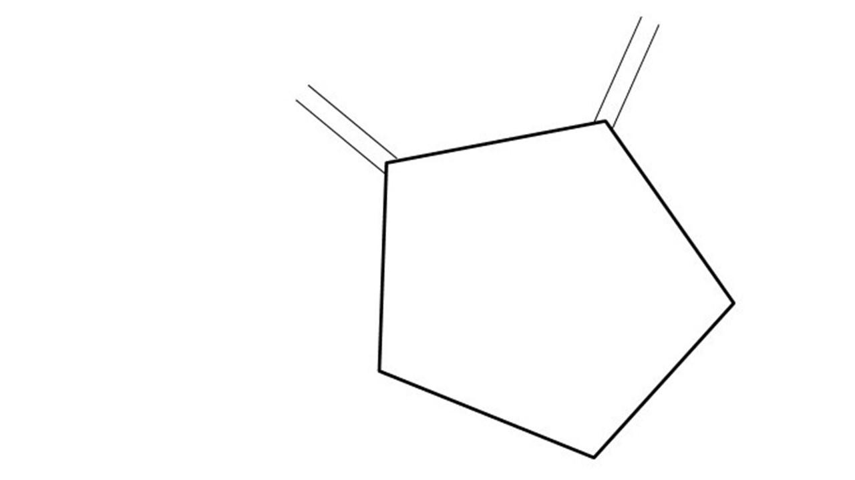
GCBASIC
PIC16Fxxxx chip Family ( Legacy )
Part 9 - Timers and Timer Interrupts
January 2025

Slide 3
GCBASIC
Like and subscribe!

Slide 4
PIC16Fxxxx
PIC16Fxxxx is a high performance PIC16
Digital and Analog peripherals
8 –bit or 10-bit ADC
Multiple communication interfaces
Serial, I2C and SPI
PWM – CCP/PWM and 16Bit
The PIC16 offers 8, 14,18,20, 28, 40 and 48-pin packages to support customers in a wide variety of applications.

Slide 5
Videos...
Install the hardware and make the board work – make LEDs work
Make four LEDs flash in a sequence
Set the LEDs to represent the value of ADC
Sequence the LEDs with a delay using the value of ADC
Using an input to set the state of the LEDs
Using the reset switch
Using the switch, ADC – make the LEDs flash in a sequence with reverse
Using the serial to display values
Using the timer0 overflow, 8bit timer, 16bit timer to flash the LEDs
Using EEProm – showing values on the serial terminal, and more constants insights
Using I2C with serial to discover I2C devices
Using an I2C GCLD display
Using a SPI GCLD display
Using PWM, many ways, to dim the LEDS
Using an external interrupt to control an LED
Using storage within the chip – Progmem, EEPROM and DATA blocks
The GCBASIC tool chain
Assembly , alternatives assemblers and MPLAB-X
Summary

Slide 6
GCBASIC Compiler
GCBASIC Compiler
GCBASIC is an Open Source compiler for PIC, AVR and LGT microcontrollers
GCBASIC supports the 16Fxxxx chip family

Slide 7
Prerequisites
Assumes you have
Installed the GCBASIC software
Installed your programmer software
Test that you have the PIC attached
You have the 4 LEDs operating
You have a POT connected
You have switches connected
You have USB/TTL serial converter
You have LCD

Slide 8
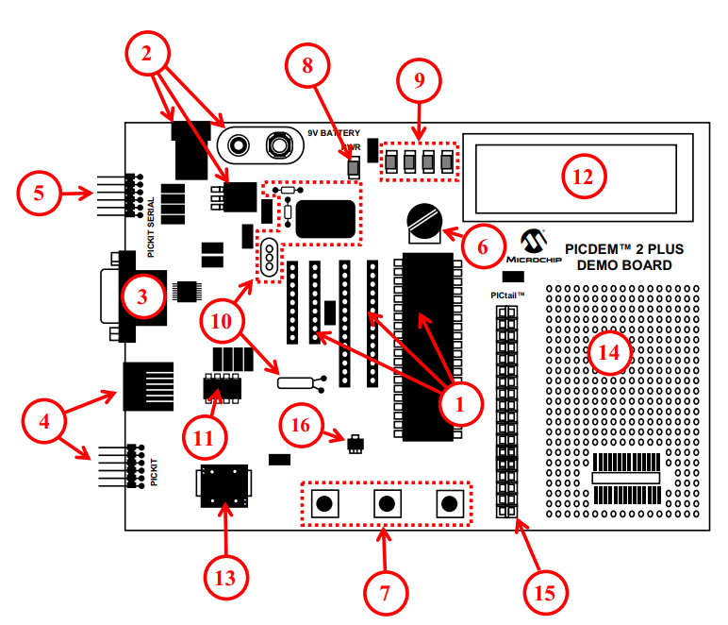
Hardware
The PICDEM 2 Plus Demonstration Board
18-, 28- and 40-pin DIP sockets (although three sockets are provided, only one device may be used at a time)
On-board, +5V regulator for direct input from 9V, 100 mA AC/DC wall adapter or 9V battery, or hooks for a +5V, 100 mA regulated DC supply
RS-232 socket and associated hardware for direct connection to an RS-232 interface
Programmer/debugger connectivity supporting MPLAB® ICD 3, MPLAB REAL ICE, PICkit 2 and PICkit 3
PICkit Serial Connector for analysis of serial communications peripherals such as SPI or I2C™
5 k pot for devices with analog inputs
Three push button switches for external stimulus and Reset
Power-on indicator LED
Four LEDs connected to PORTB
On-board external oscillators including: a) Unpopulated DIP socket for canned crystal oscillator (Y2) b) RC oscillator circuit (R4, C3) c) Unpopulated holes for crystal connection (Y1) d) 32.768 kHz crystal for Timer1 clock operation (Y3)
32K x 8 Serial EEPROM
LCD display
Piezo buzzer
Prototype area for user hardware
Expansion Header for PICtail™ daughter card connectivity or user access to
MCUs
Microchip TC74 thermal sensor

Slide 9
Hardware
Hardware
------------PORTA---------------
Bit#: -7---6---5---4---3---2---1---0---
IO: ------------SW2-------------ADC--
IO: ---------------------------------
------------PORTB----------------
Bit#: -7---6---5---4---3---2---1---0---
IO: ----------------LED-LED-LED-LED--
IO: ---------------------------------
------------PORTC----------------
Bit#: -7---6---5---4---3---2---1---0---
IO: ----TX---------------------------
IO: ---------------------------------
------------PORTD----------------
Bit#: -7---6---5---4---3---2---1---0---
IO: -PWR-EN--RW--RS--DB7-DB6-DB5-DB4-
IO: ---------------------------------
------------PORTE----------------
Bit#: -7---6---5---4---3---2---1---0---
IO: ----------------RST---------------
IO: ---------------------------------
Prototype Board
Power 5v0
Programmer
LEDs & resistors
Switches
TTL/USB
LCD

Slide 10
Timer Primer

Slide 11
Timer Block Diagram
Timers generate the accurate time delays. The microcontroller can also generate/measure the required time delays by running loops, in your program, but the timer/counter relieves the CPU from that operation by using the prescalar A timer is nothing but a simple binary counter that can be configured to count clock pulses(Internal/External). A register increments from a specific value. Once it reaches the maximum value, it will roll back to zero setting up an OverFlow flag and generates the interrupt ... if enabled.

Slide 12
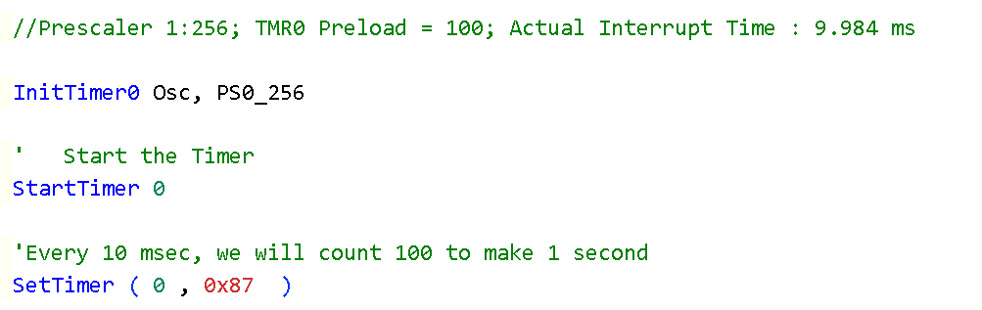
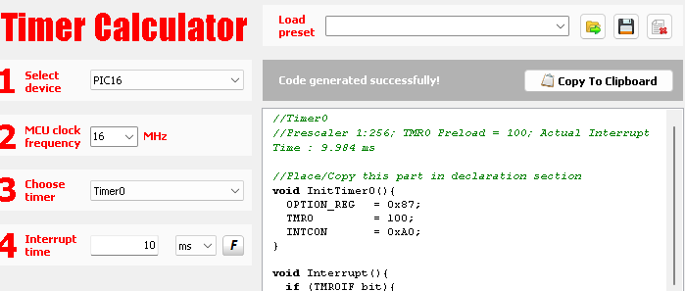
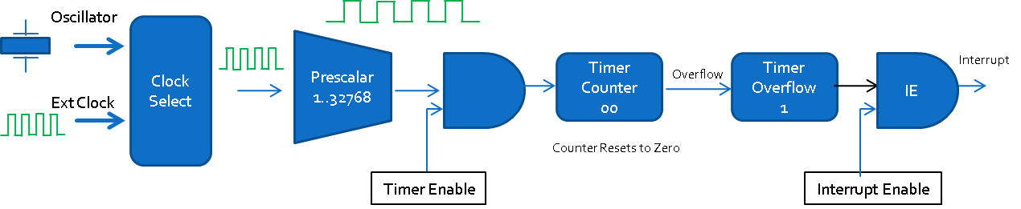
Timer Overview

Slide 13
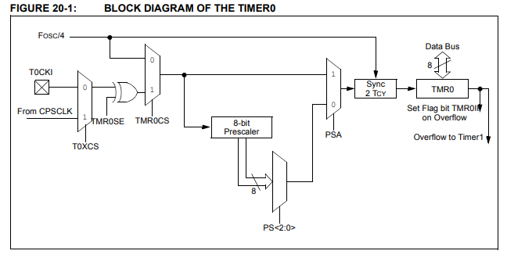
Timer0 block diagram

Slide 14
Timer Block Diagram
Oscillator
Clock Select
Prescalar
1..32768
Interrupt
Timer Counter 00
Overflow
Timer Overflow
1
IE
Ext Clock
Counter Resets to Zero
Timer Enable
Interrupt Enable
Timers generate the accurate time delays. The microcontroller can also generate/measure the required time delays by running loops, in your program, but the timer/counter relieves the CPU from that operation by using the prescalar A timer is nothing but a simple binary counter that can be configured to count clock pulses(Internal/External). A register increments from a specific value. Once it reaches the maximum value, it will roll back to zero setting up an OverFlow flag and generates the interrupt ... if enabled.

Slide 15
Timer Block Diagram
Oscillator
Clock Select
Ext Clock

Slide 16
Timer Block Diagram
Oscillator
Clock Select
Prescalar
1..32768
Ext Clock

Slide 17
Timer Block Diagram
Oscillator
Clock Select
Prescalar
1..32768
Ext Clock
Timer Enable

Slide 18
Timer Block Diagram
Oscillator
Clock Select
Prescalar
1..32768
Timer Counter 100
Timer Overflow
0
Ext Clock
Set TMR0 Counter
Timer Enable

Slide 19
Timer Block Diagram
Oscillator
Clock Select
Prescalar
1..32768
Timer Counter 101
Timer Overflow
0
Ext Clock
TMR0 Counter
Timer Enable

Slide 20
Timer Block Diagram
Oscillator
Clock Select
Prescalar
1..32768
Timer Counter ….
Timer Overflow
0
Ext Clock
TMR0 Counter
Timer Enable

Slide 21
Timer Block Diagram
Oscillator
Clock Select
Prescalar
1..32768
Timer Counter 254
Timer Overflow
0
Ext Clock
Timer Enable

Slide 22
Timer Block Diagram
Oscillator
Clock Select
Prescalar
1..32768
Timer Counter 255
Timer Overflow
0
Ext Clock
TMR0 Counter
Timer Enable

Slide 23
Timer Block Diagram
Oscillator
Clock Select
Prescalar
1..32768
Timer Counter 00
Overflow
Timer Overflow
1
Ext Clock
TMR0 Counter
Timer Enable

Slide 24
Timer Block Diagram
Oscillator
Clock Select
Prescalar
1..32768
Timer Counter 00
Overflow
Timer Overflow
1
Ext Clock
TMR0 Counter
rolls over to Zero
Timer Enable

Slide 25
Timer Block Diagram
Oscillator
Clock Select
Prescalar
1..32768
Timer Counter 00
Overflow
Timer Overflow
1
IE
Ext Clock
Timer Enable
Interrupt Enable

Slide 26
Timer Block Diagram
Oscillator
Clock Select
Prescalar
1..32768
Interrupt
Timer Counter 00
Overflow
Timer Overflow
1
IE
Ext Clock
Timer Enable
Interrupt Enable

Slide 27
Timer Block Diagram
Oscillator
Clock Select
Prescalar
1..32768
Interrupt
Timer Counter 00
Overflow
Timer Overflow
1
IE
Ext Clock
Timer Enable
Interrupt Enable

Slide 28
Lab
Examine the sample code
Review the results
Timer0 Overflow
8 Bit timer
16 Bit timer

Slide 30
Videos...
Install the hardware and make the board work – make LEDs work
Make four LEDs flash in a sequence
Set the LEDs to represent the value of ADC
Sequence the LEDs with a delay using the value of ADC
Using an input to set the state of the LEDs
Using the reset switch
Using the switch, ADC – make the LEDs flash in a sequence with reverse
Using the serial to display values
Using the timer0 overflow, 8bit timer, 16bit timer to flash the LEDs
Using EEProm – showing values on the serial terminal, and more constants insights
Using I2C with serial to discover I2C devices
Using an I2C GCLD display
Using a SPI GCLD display
Using PWM, many ways, to dim the LEDS
Using an external interrupt to control an LED
Using storage within the chip – Progmem, EEPROM and DATA blocks
The GCBASIC tool chain
Assembly , alternatives assemblers and MPLAB-X
Summary

Slide 31
GCBASIC
PIC16Fxxxx chip Family ( Legacy )
Part 9 - Timers and Timer Interrupts

